Slide 1

Implementation of the Water Resources Classification System and Determination of the Resource Quality Objectives for Significant Water Resources in the Letaba Catchment
7: Natural and present day hydrology – modelling
31 October 2013
Presented by:
Pieter van Rooyen

Slide 2
Letaba NWRCS steps
1: Delineate units of analysis and describe the status quo
2: Initiation of stakeholder process and catchment visioning
3: Quantify EWRs and changes in EGSA
7: Gazette class configuration
4: Identification and evaluation of scenarios within IWRM
5: Stakeholder process
6: Resource Quality Objectives (EcoSpecs & water quality (user))
Hydrological Analysis: Where does it fit in?

Slide 3
Hydrological Analysis
Hydrology was revised for entire study area
Applied rainfall-runoff model
Define land use from validation study and other sources
Evaluation of flow gauges and dam balance information
Calibration – matching model flows with recorded data
Incorporate groundwater – surface water interaction modeling
Generate monthly natural flow time series for the period 1920 to 2010:
  62 biophysical nodes, including;
  7 Ecological Water Requirement Sites

Slide 4
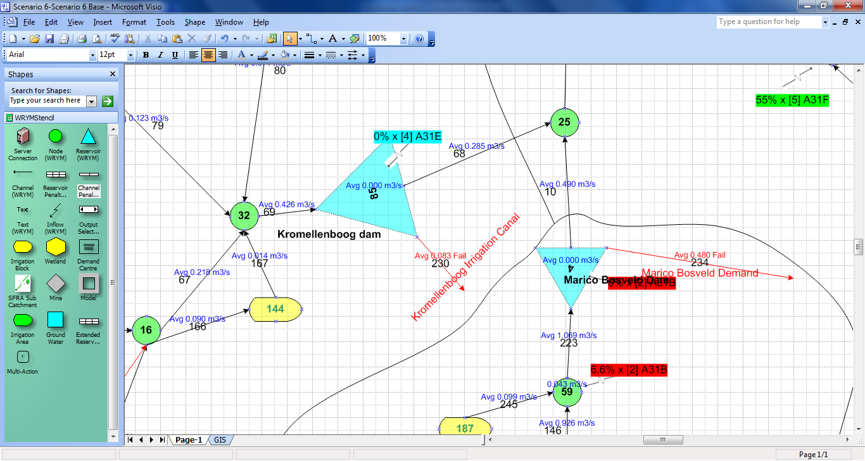
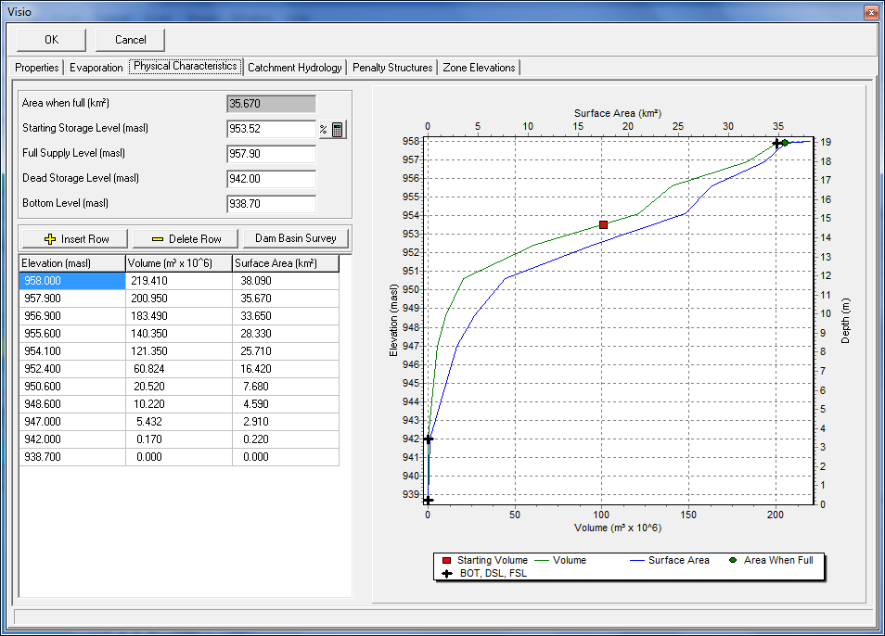
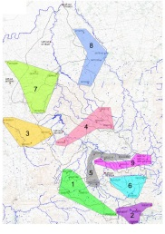
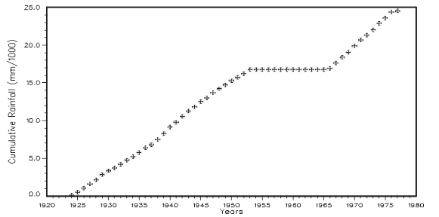
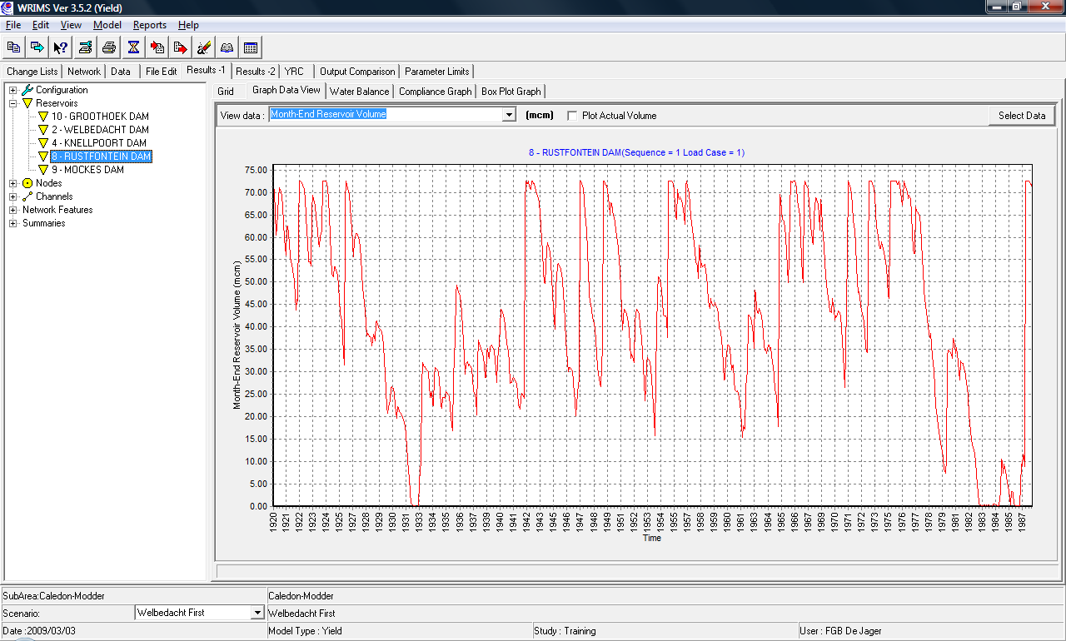
Hydrological Modelling
Hydrological
analysis
Water Resource System Analysis
Network
Physical Characteristics
Rainfall
Flow
calibration
Historical simulation
Natural monthly flows
Present Day monthly flows

Slide 5
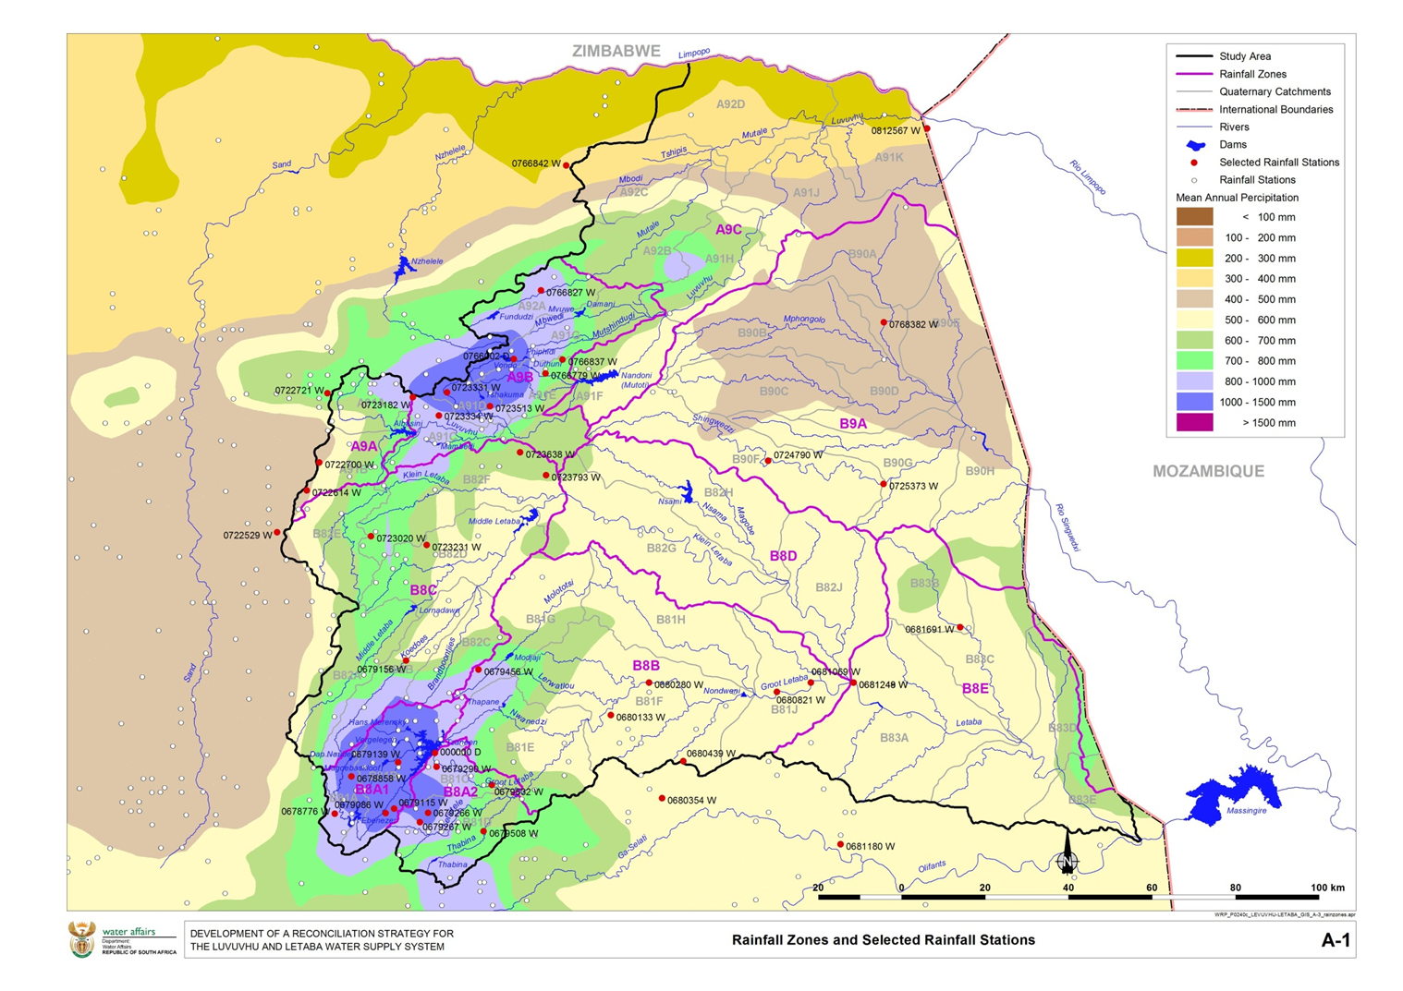

Slide 6
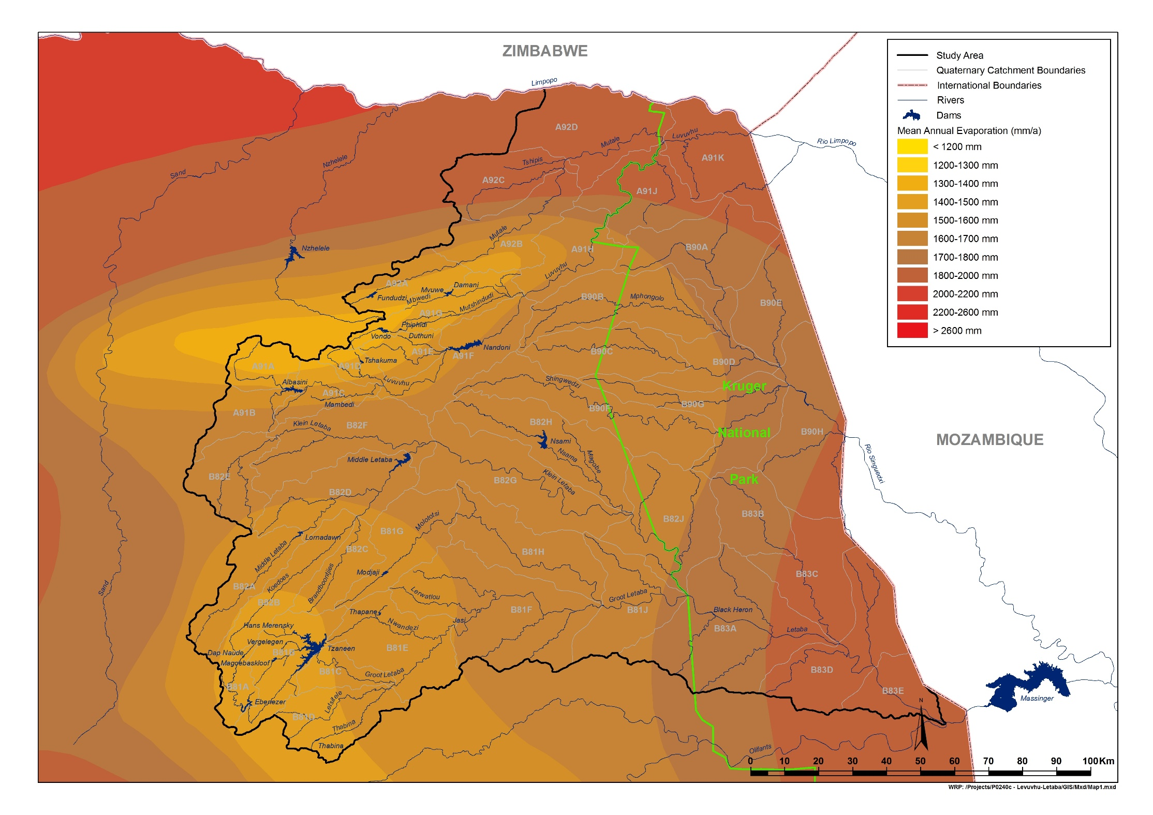

Slide 7
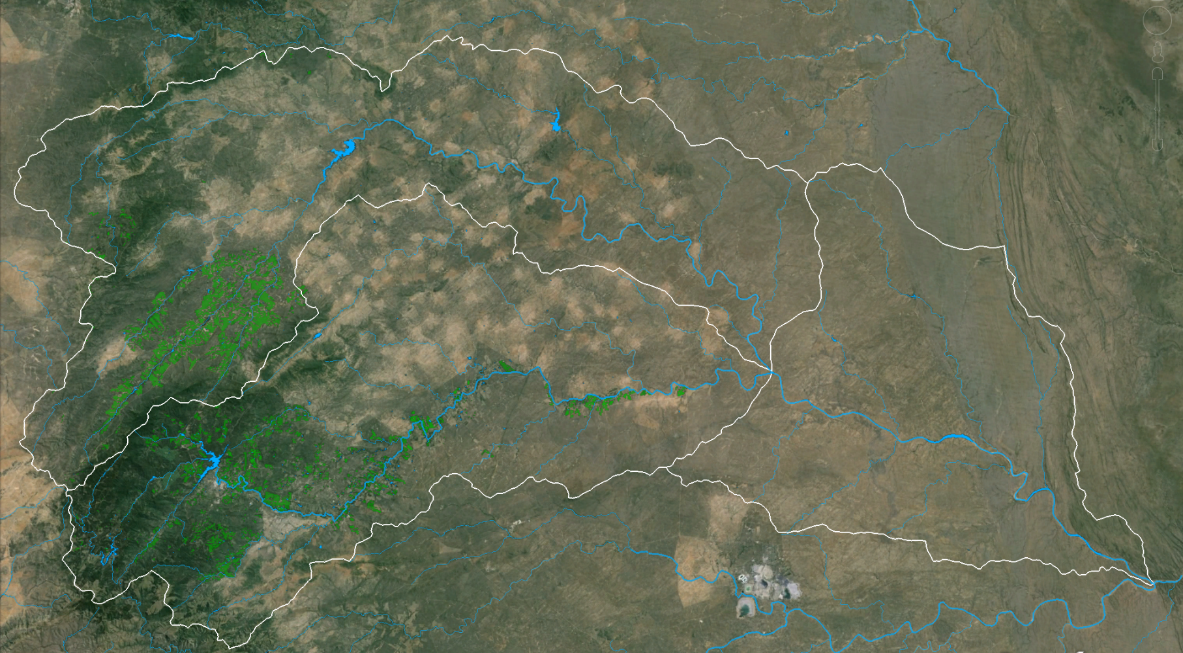
Letaba Catchment Overview

Slide 8
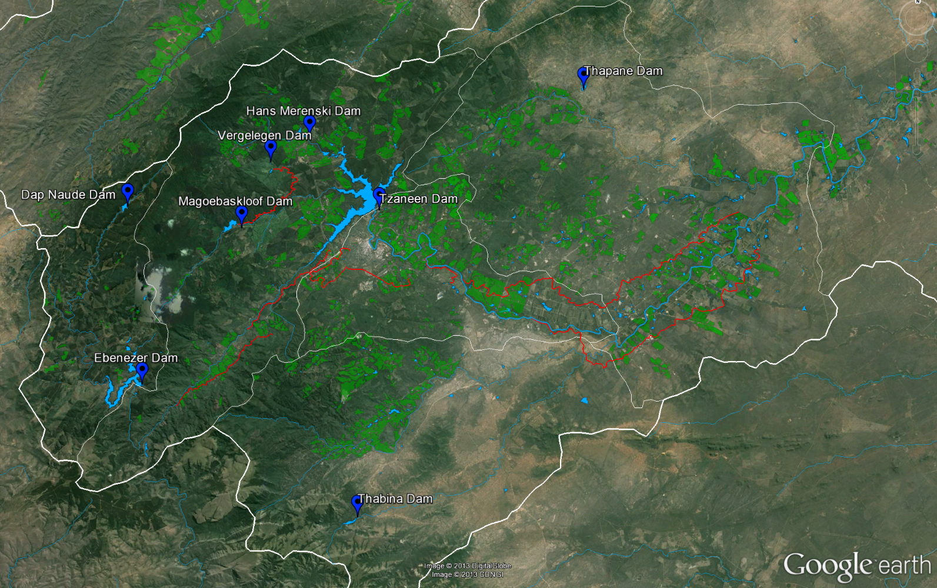
Infra-structure (1)

Slide 9
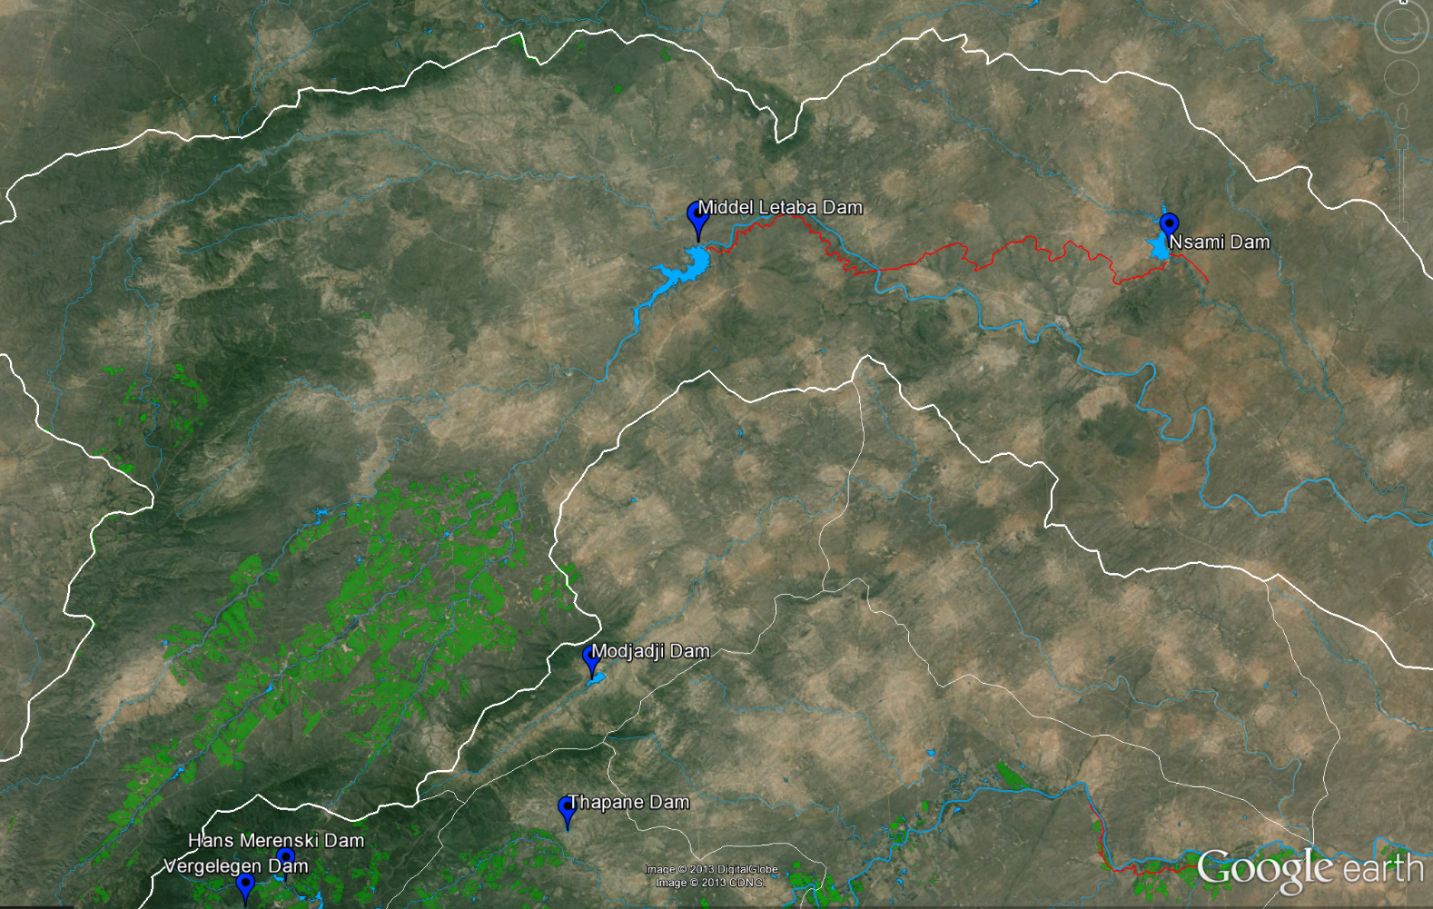
Infra-structure (2)

Slide 10
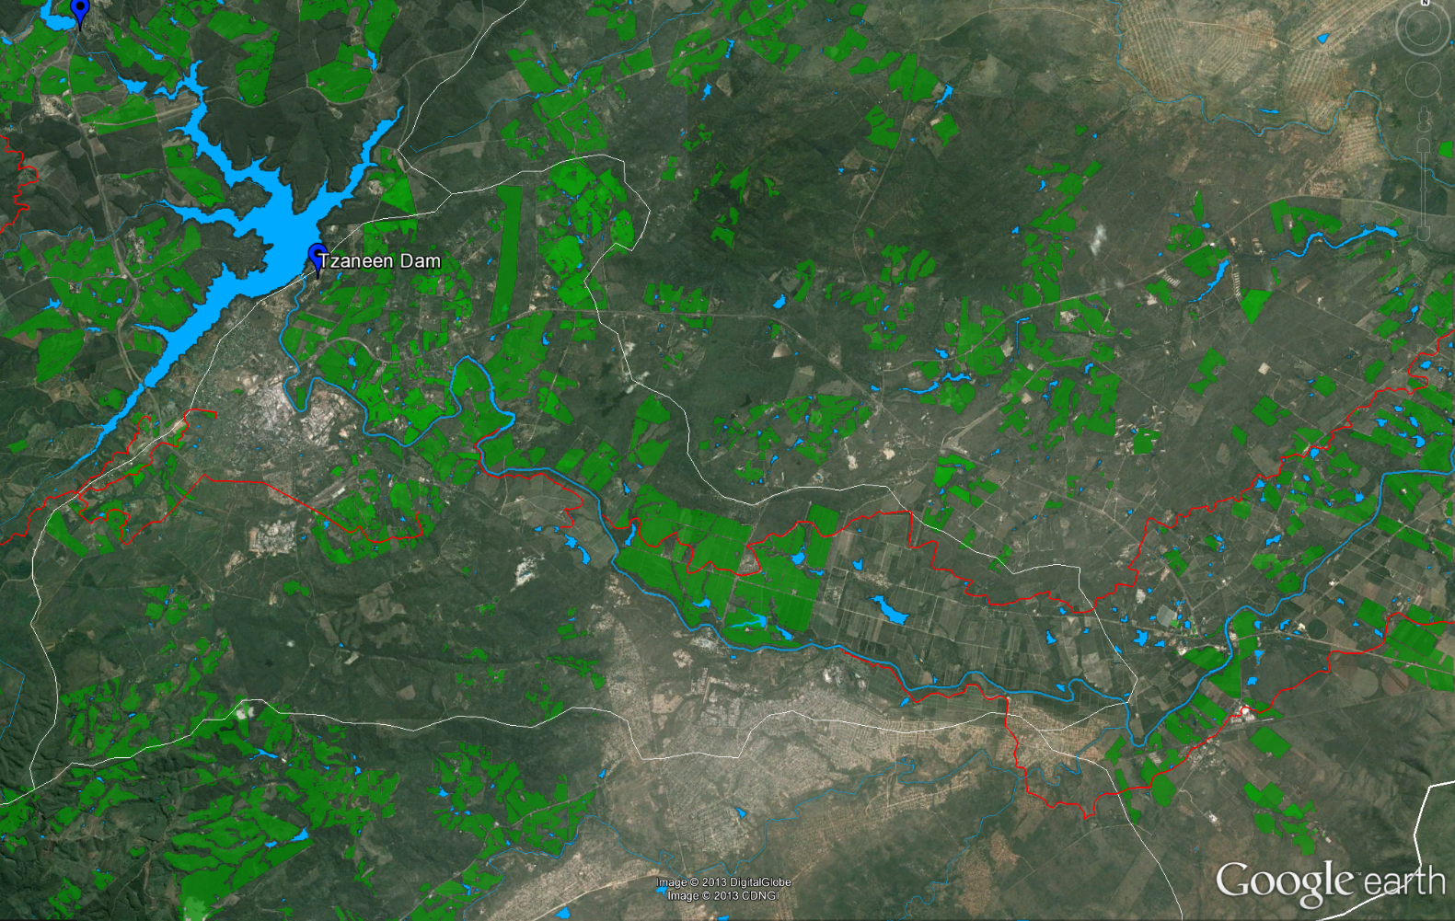
Infra-structure (3)

Slide 11
Larger Dams
Name | Area | DWA # | Date of Survey | FSA (km²) | Net FSC (10⁶m³) | Gross FSC (10⁶m³)
Tzaneen | Upper Groot Letaba | B8R005 | 1990-10-01 | 11.6 | 156.5 | 157.3
Ebenezer | Upper Groot Letaba | B8R001 | 1985-10-01 | 3.7 | 69.1 | 70
Magoebaskloof | Upper Groot Letaba | B8R003 | 1999-10-01 | 0.4 | 4.8 | 4.8
Thabina | Upper Groot Letaba | - | - | 0.2 | - | 2.6
Dap Naude | Upper Groot Letaba | B8R006 | 1980-02-07 | 0.3 | 1.9 (2.5) | 2.5
Hans Merensky | Upper Groot Letaba | B8R002 | 1987-10-01 | 0.5 | 1.2 | 1.2
Vergelegen | Upper Groot Letaba | B8R004 | 1977-05-03 | 0.1 | 0.3 | 0.3
Modjadji | Lower Groot Letaba | B8R011 | - | 0.5 | - | 7.2
Thapane | Lower Groot Letaba | - | - | 0.3 | - | 1.1
Middel Letaba | Middel Letaba | B8R007 | 1986-02-24 | 19.3 | 171.9 | 184.2
Nsami | Middel Letaba | B8R009 | 1995-05-09 | 5.0 | 21.9 | 24.1
Total |  |  |  | 41.9 |  | 455.3

Slide 12
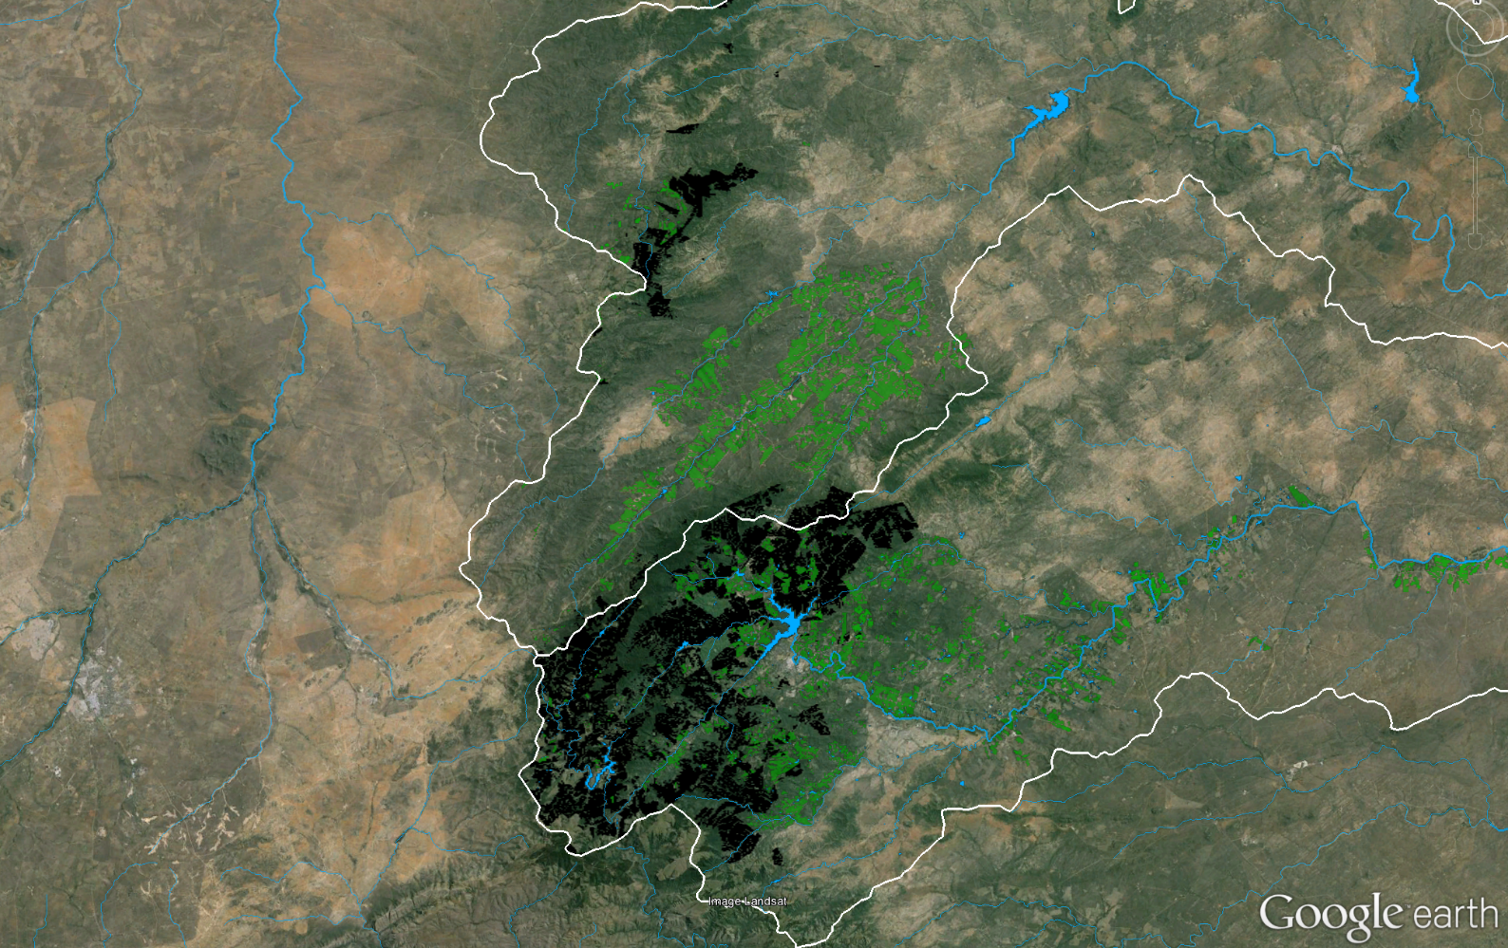
Forestry

Slide 13
Forestry – Areas and Requirements
Quaternary | Eucalyptus | Pine | km² | 10⁶m³/a
B81A | 82.7% | 17.3% | 97.8 | 16.64
B81B | 91.3% | 8.7% | 182.8 | 23.60
B81C | 100.0% | 0.0% | 11.2 | 1.46
B81D | 90.5% | 9.5% | 50.9 | 11.68
B81E | 100.0% | 0.0% | 11.7 | 0.40
B81G | 100.0% | 0.0% | 0.5 | 0.01
B82A | 95.7% | 4.3% | 4.9 | 0.30
B82B | 94.4% | 5.6% | 7.9 | 0.46
B82C | 100% | 0% | 5.0 | 0.29
B82D | 100% | 0% | 11.4 | 0.42
B82E | 100% | 0% | 18.7 | 0.39
B82F | 100% | 0% | 11.0 | 0.31
Total |  |  | 413.8 | 56.0

Slide 14
Irrigation - Requirements
Area | Scheme (Ebenezer and Tzaneen) |  | Diffuse |  | Total 10⁶m³/a (% Total)
 | From Canals | From RoR | Surface | Groundwater
Groot Letaba (B81) | 58.5 | 29.7 | 126.2 | 50.5 | 264.9 (73%)
Middel Letaba (B82) | - | - | 62.4 | 35.7 | 98.1 (27%)
Total (% Total) | 58.5 (16%) | 29.7 (8%) | 188.6 (52%) | 86.2 (24%) | 363.0 (100%)

Slide 15
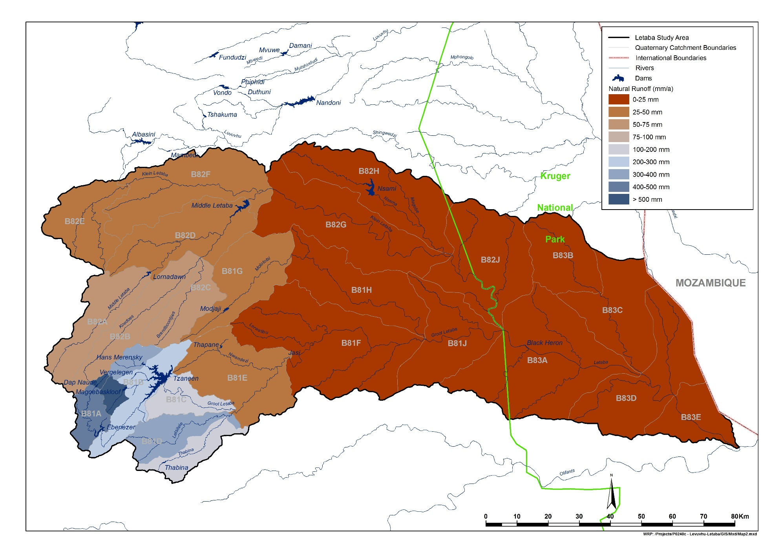
Natural Unit Runoff (mm/annum)

Slide 16
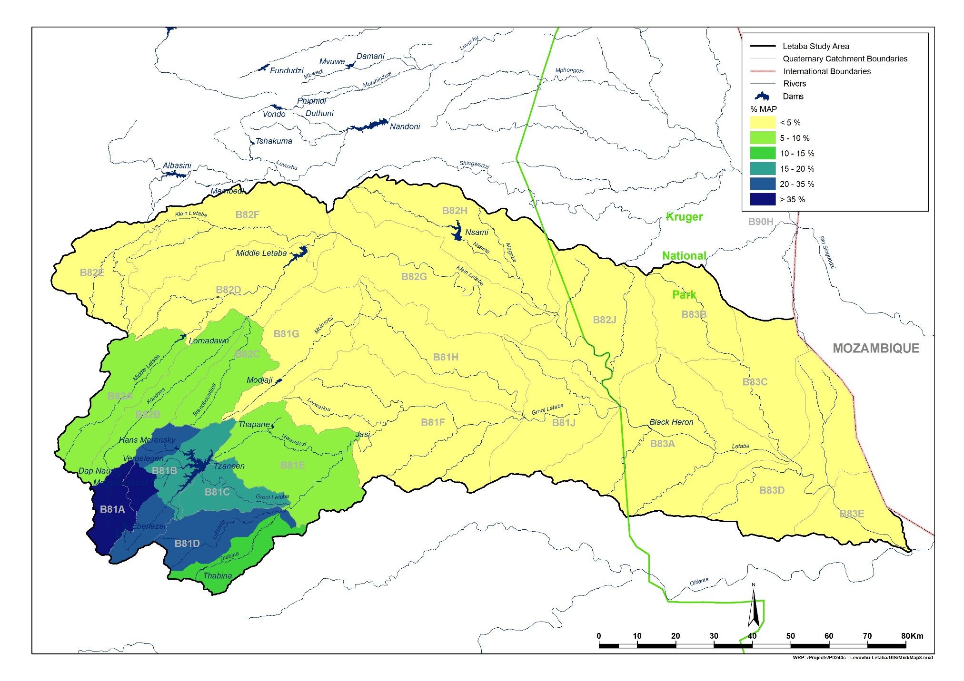
Runoff as % of Mean Annual Presipitation

Slide 17
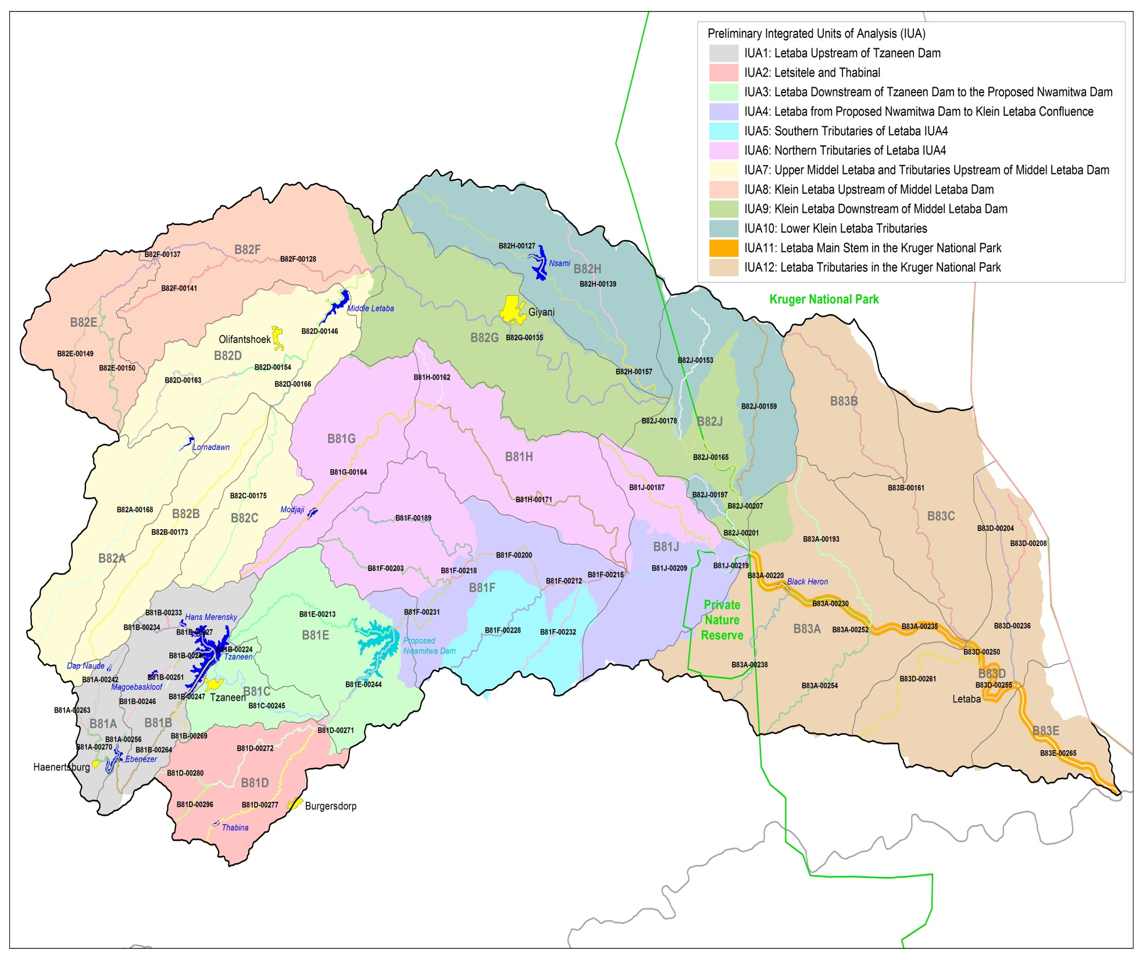
Natural and Present Day flows:
62 biophysical nodes, including;
7 Ecological Water Requirement Sites

